Slide 1
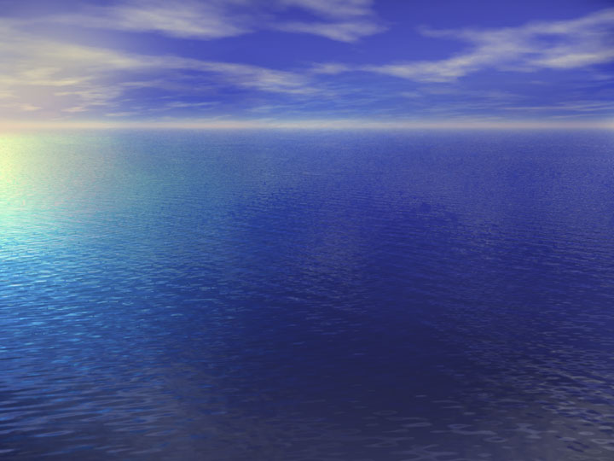
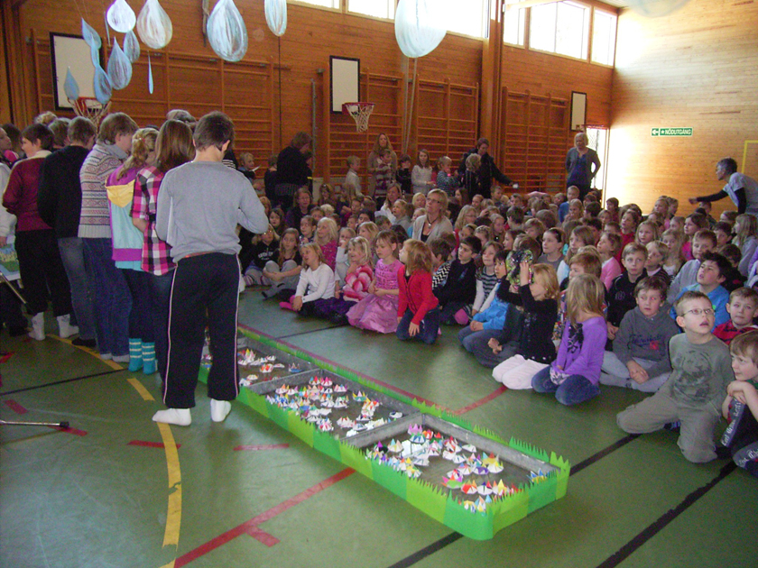
World Water Day
On the 22 March the World Water Day we had a ceremony program in our school. All students and all the staff met in the sports hall. The hall was decorated with raindrops hanging from the ceiling and a lot of water bowls on the floor. When the students entered the hall singing a song about water circulation they laid down small paper flowers they had coloured. When those flowers reached the surface of water they opened and blossomed.

Slide 2
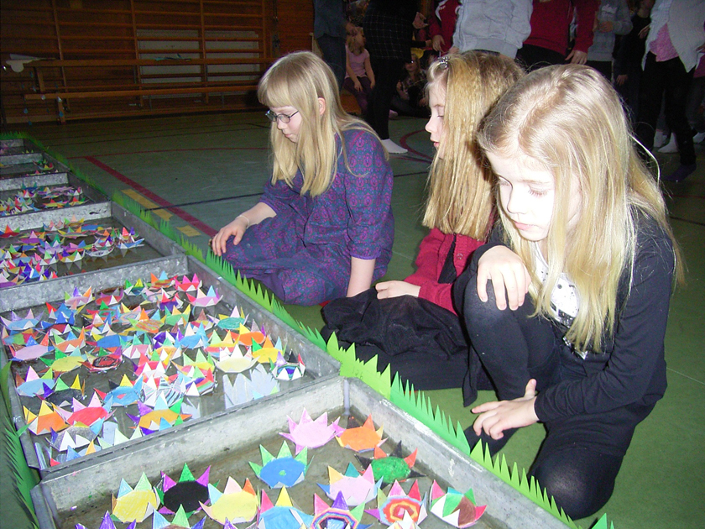
All classes at school made a performance about their work with water. Some sang a song, others told about their knowledge of water. Some students in 5th grade had a band they called Waterfall, and they played a couple of tracks and made big success.

Slide 3
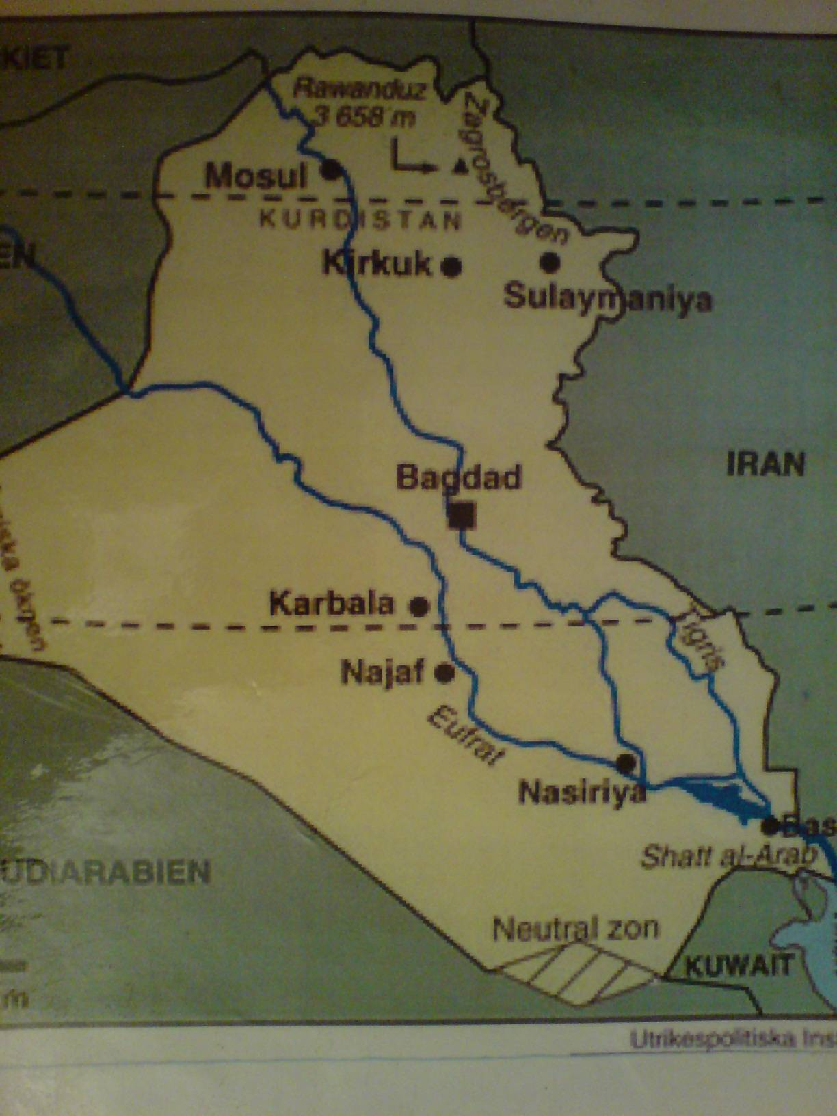
Water for life
Class 6A had a presentation of our project for the whole school. We started with a presentation of our two countries, Sweden and Iraq. We had found out that our countries are quite similar in area but totally different comparing the nature and climate. Sweden has four different seasons with rather warm summers and cold winters. In Iraq there is not so big differences between summer and winter.

Slide 4
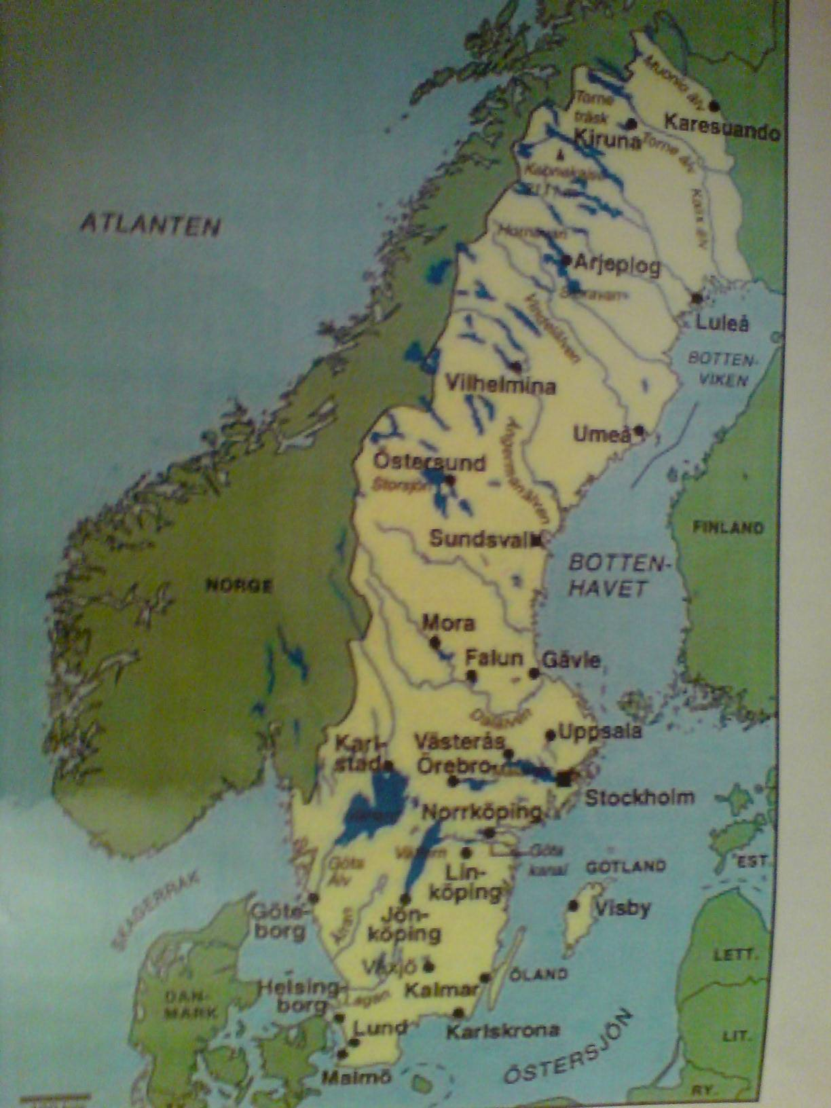
Comparing the nature there are many differences between our two countries. In Sweden we have large forests all over the country and our good parts are cultivated. In Sweden we also have thousands of lakes. In Irak there is not so much area cultivated as in Sweden but large areas of desert which we don´t have in Sweden at all. Our conclusion to that is that Sweden has much more availability to water than Iraq.

Slide 5
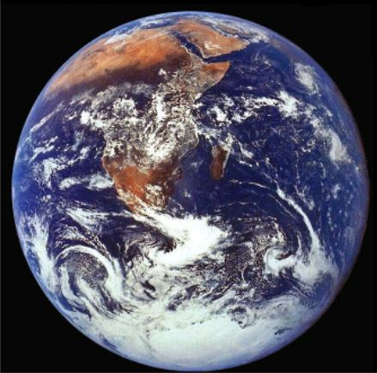
How many Tellus do we have?
We had compared the environmental foot prints our two countries make and found out that if all people in the world would use the natural resources like Swedes do, we should need almost four earths. In the way the Iraqis live, we should need only a half. We have to consider our way of life in our country.

Slide 6
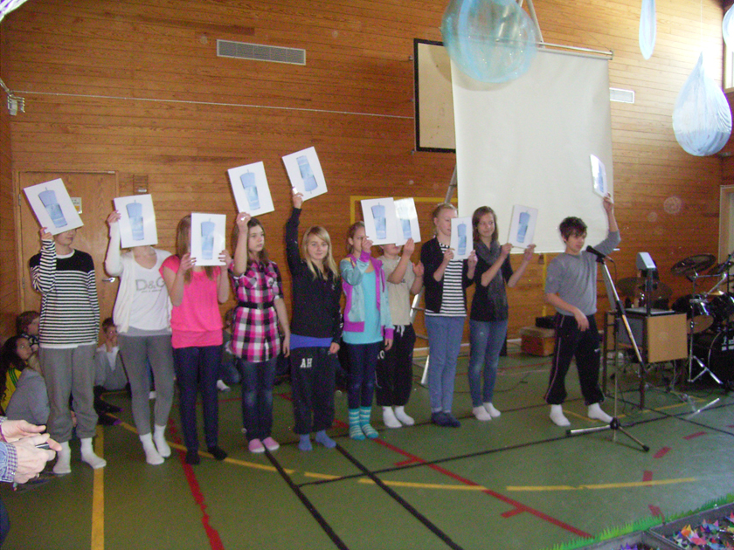
Here we show, with pictures of glasses of water, how much we use in our school and how much you use in Baghdad.

Slide 7
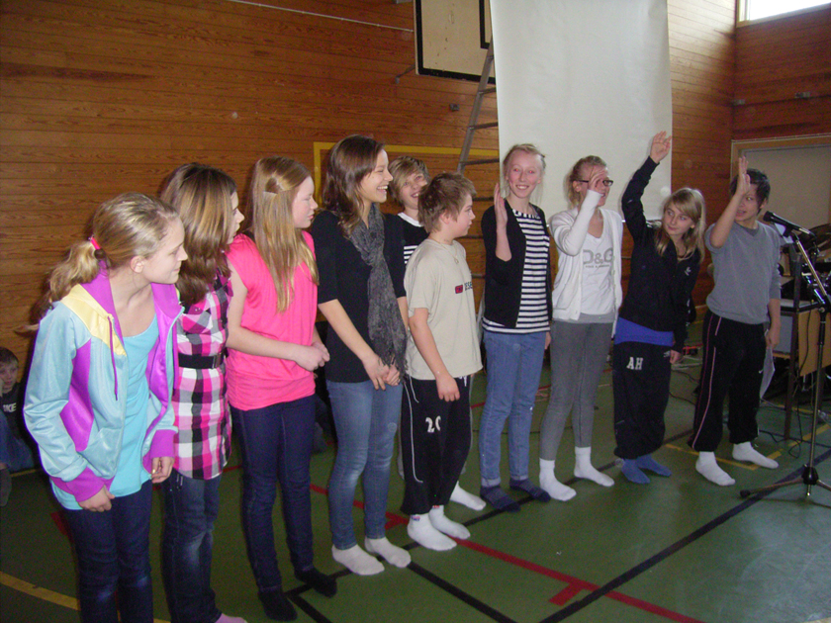
This is a small part of the students in class 6A, Bryngelstorpskolan, Nyköping, Sweden, at their presentation of the project Water for life.

